Slide 1
Drowsiness Detection In Automobile Drivers
DATA 270: Data Analytics Process
Group1:
Priya Varahan
Priyanka Akula
Pooja Manjunatha
Nandini S Nair

Slide 2
Introduction
Project Background
Project Workflow
Project Requirements
Technology and Literature Survey
Project Resources Requirements
Project Plan
Data Collection
Data Exploration
Data Processing
Machine Learning Models
Model Comparison
Inference
References
Conclusion & Future Work
Agenda

Slide 3
Introduction
● The objective of this project is to utilize deep learning models in order to categorize drowsiness in drivers of automobiles. Data from videos and images will be analyzed by the algorithms in order to classify the states of drowsiness in drivers.
●Ultimately, the goal is to diminish the frequency of road accidents and enhance the safety of road travel for all individuals.

Slide 4
Project Background
Motivation
Need and importance
Filling previous research gaps.
Annotating datasets for comprehensive insights.
Achieving efficiency and high f1_score with deep learning
Deep learning provides improved efficiency, scalability, and accuracy in classifying drowsiness, in comparison to older human classification methods.
Improving comprehension of driver fatigue.
Enacting focused approaches in identifying drowsiness
Targeted Problem
Deliverables
Automating the process of drowsiness detection utilizing deep learning models to pick up on minor behavioral clues and make it better at detecting driver fatigue.
Create and execute a deep learning model with high accuracy and F1 score to classify drowsiness in drivers.

Slide 5
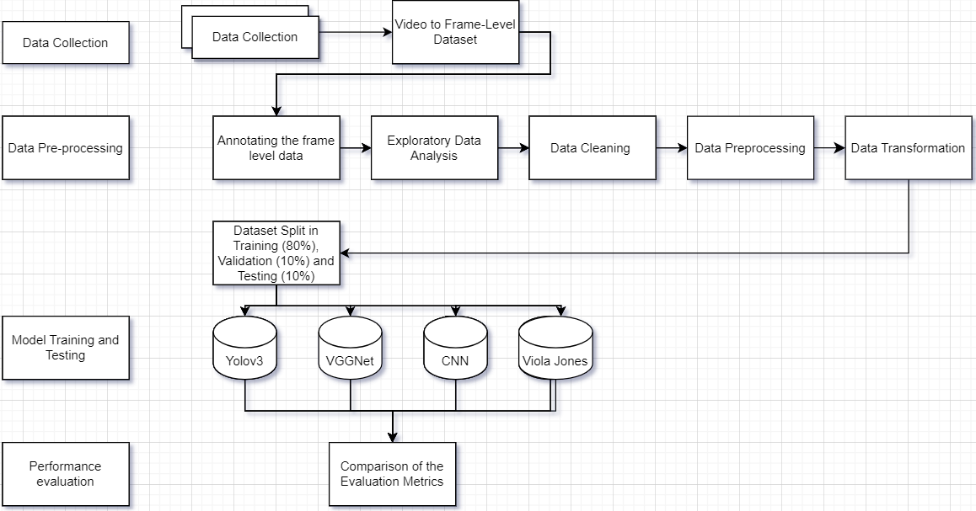
Project Workflow

Slide 6
Project Requirements
Annotate and Ensure frame level image quality, consistency, completeness.
Use deep learning algorithms such as VGGNet, CNN, Viola Jones, YOLOV3
Data Requirements
Models
Training
Identification
Train models on appropriate data and tune hyperparameters to minimize error and prevent overfitting
Identify trends and temporal patterns, and contextual cues

Slide 7
Project Requirements
Extracting facial landmarks, temporal dynamics ,eye state from drowsiness data
Based on evaluation feedback, update the model
Feature Engineering
Refine Model
Deployment
Model Evaluation
Monitor performance of model and final documentation
Evaluate model performance using metrics such as accuracy and f1-score

Slide 8
Technology and Literature survey
PAPER TITLE | AUTHORS | DATASET | MODELS | RESULTS (Accuracy) | SUMMARY
Real-Time Driver Drowsiness Detection Using Dlib And openCV | Prashant et al. (2022) | Video Acquisition records | Haar feature based classifier, decision tree | 60% | By monitoring eyes and facial landmarks with Dlib, this study introduces the Eyes Aspect Ratio to detect driver fatigue
Driver Drowsiness Detection System Using Deep Learning Method to Reduce Risk Accident | Mochamad et al. (2023) | 2000 Images from various source of internet | YOLOv5 | 73% | The study detect driver fatigue, signaling alerts and recording incidents via LoRa communication for enhanced safety in transportation
Drowsiness monitoring in real-time based on supervised descent method | Nikolay et al.(2017) | ULg Multimodality Drowsiness Database | SVM Classifier, Viola-Jones | 83% | The authors try a real-time detection system using Viola-Jones and Supervised Descent Method for drowsiness alert based on eye and mouth tracking

Slide 9
Technology and Literature survey
PAPER TITLE | AUTHORS | DATASET | MODELS | RESULTS (Accuracy) | SUMMARY
Development of a Drowsiness Detection of a Car Driver by Eye Detection Methodology of Image Processing | Dibyendu et al. (2015) | Image dataset from matlab | Viola-Jones | 54% | The author proposing a eye pattern detection based drowsiness
EEG-Based Real-Time Drowsiness Detection Using Hilbert-Huang Transform | Rui et al. (2015) | 2000 Images from various source of internet | HHT, FFT | 70% | Asurvey found that using EEG signals with Hilber-Huang Transform, offering enhanced accuracy and potential for wearable devices.
Real-Time Student Emotion and Drowsiness Detection Using YOLOv5 and CNN for Enhanced Learning | Afsaret al.(2023) | Video stream dataset | CNN, YOLOV5 | 93.12% and 87% | Proposing a computer vision-based system to detect student attention, behavior, and emotions in classrooms, enhancing teacher quality assessment.

Slide 10
Project Resource Requirements
Hardware Requirements
Resources | Configuration | Purpose | Cost
Local Machine | Chip featuring an 7-core CPU, 7-core GPU, 4 performance cores and 4 efficiency cores 2TB SSD, 16-core Neural Engine, with 64GB RAM | Processor required for Jupyter notebooks,Visual Studio to run Deep learning models | 1600$
Google colab cloud server | IIntel(R) Xeon(R) CPU memory - 25 GB, opmode(s): 64-bit | Company profits | free

Slide 11
Project Libraries and Packages Requirements
Libraries and Packages Requirements
 | Library | Method | Usage
Pandas | pandas pandas,plotting | DataFrame, Series autocorrelation plot | visualization, manipulation, and time series analysis
Matplotlib | Matplotlib.pyplot | pyplot | Used for data visualization and plotting
numpy | numpy | numpy.array() | Image pixels as matrices and mathematical operations
Scikit-Learn | Sklearn.metrics | Mean_squared_error | Used for model evaluation process
OpenCV | cv2 | cv2.imread() | Image processing
PyTorch & transformers | torch , transformers | pipeline()torch.tensor() | Technique for model building

Slide 12
Project Tools and Platforms Requirements
Tools and Licenses
 | Purpose | Licenses | Cost
Jupyter Notebook | Code development | Proprietary | Free
Visual Studio | Code development | Proprietary | Free
GitHub | Via web version system for oversight | Multiple | Free
Jira | To set up project management plan, track project tasks and issues. | Proprietary | free
Google Cloud SDK | Establish connection between local and remote GCP platform via CLI | free | free
Google Docs, slides | Word processing, spreadsheet, and presentation applications | Proprietary | Free
Discord, WhatsApp, Email | For team meetings | Free | Free

Slide 13
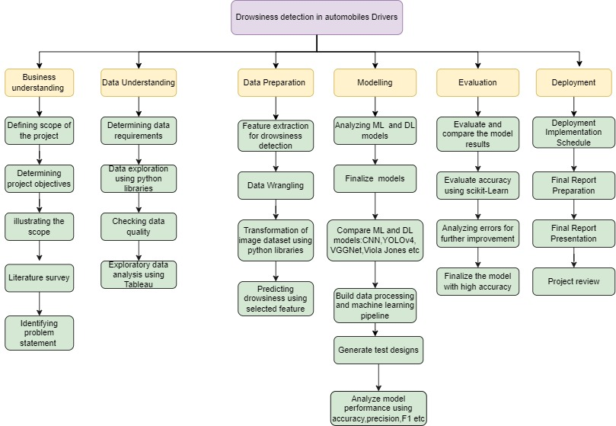
Project Plan- WBS

Slide 14
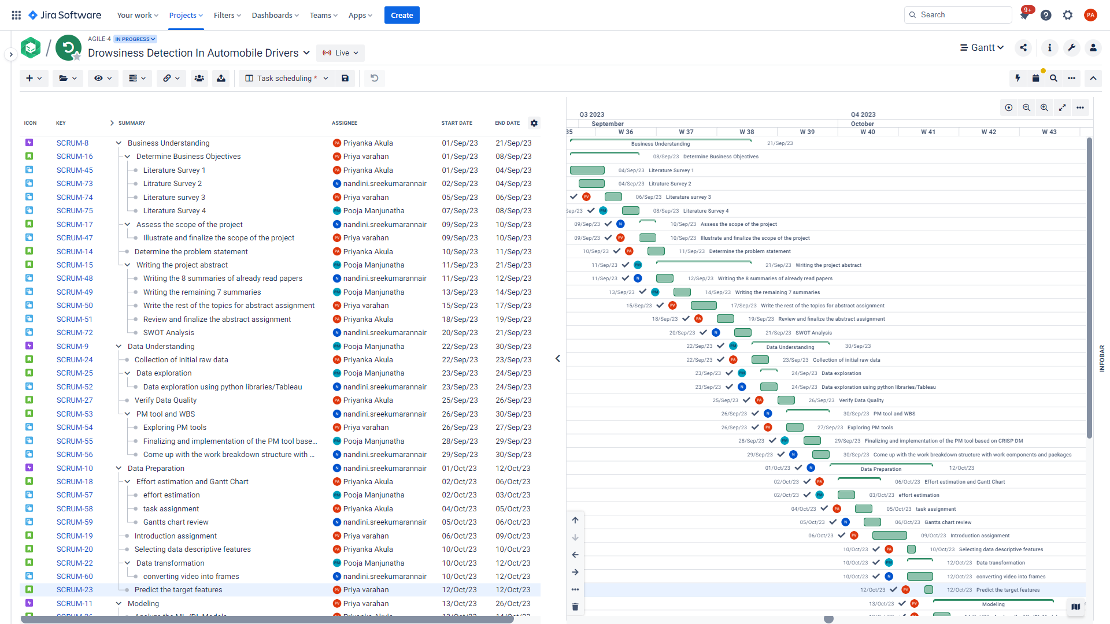
Project Plan- Gantt Chart

Slide 15
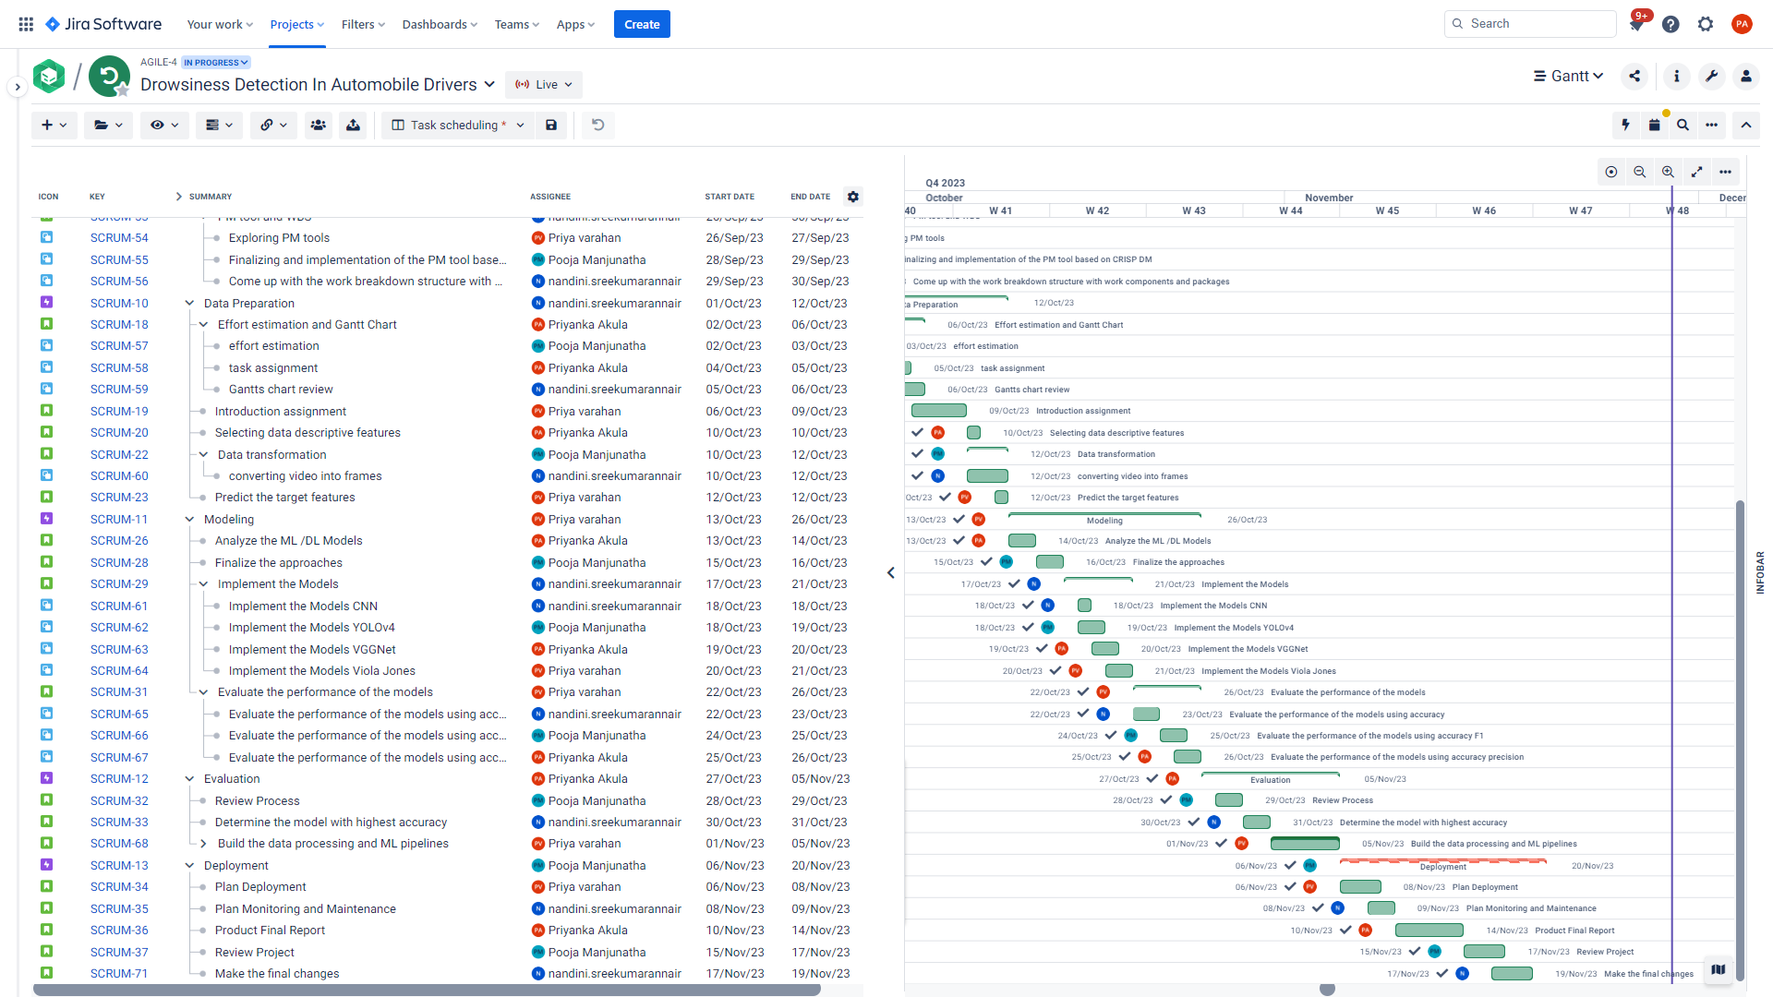
Project Plan- Gantt Chart
Presenting the Gantt chart to show the task division and timely completion of task by each individual member in group

Slide 16
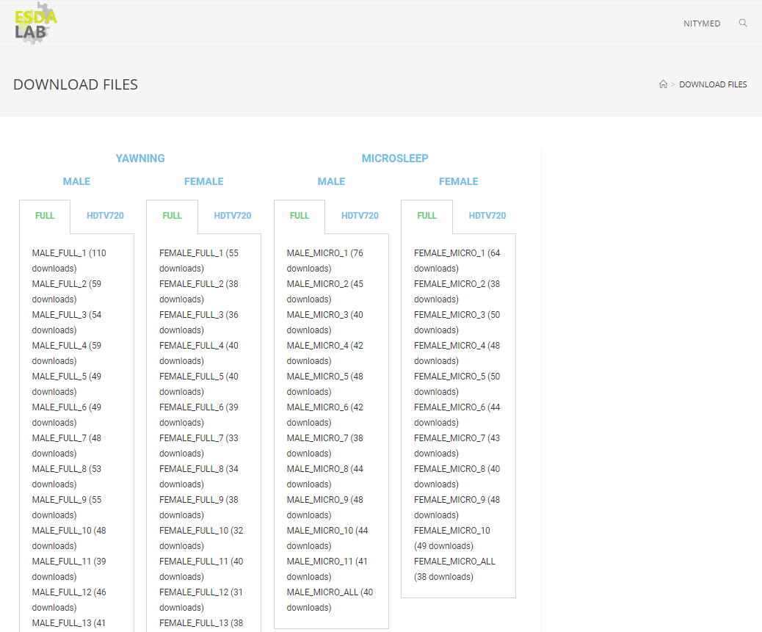
Data Collection
The dataset NITYMED (Night Time Yawning Microsleep Eyeblink Driver Distraction) was contributed by the research institute ESDA Lab.
The NITYMED dataset is downloaded from the original path by manual from the ESDA lab.
This information is open to the public on the website and can be downloaded by filling out a request form.
A set of 130 movies was collected of real drivers moving their cars at night, when detecting drowsiness is more important. There are 4.12 GB of movie files on it, which we collected over two days.

Slide 17
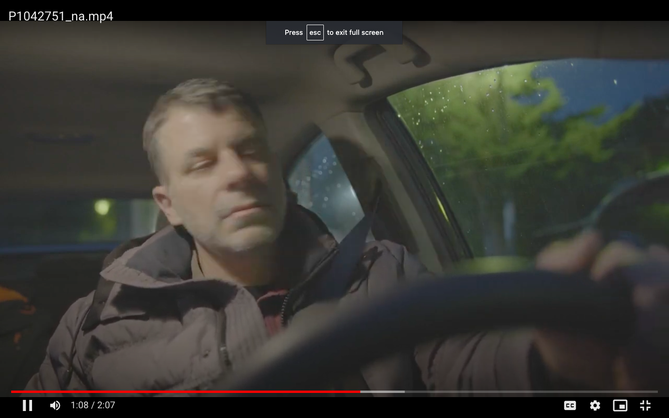
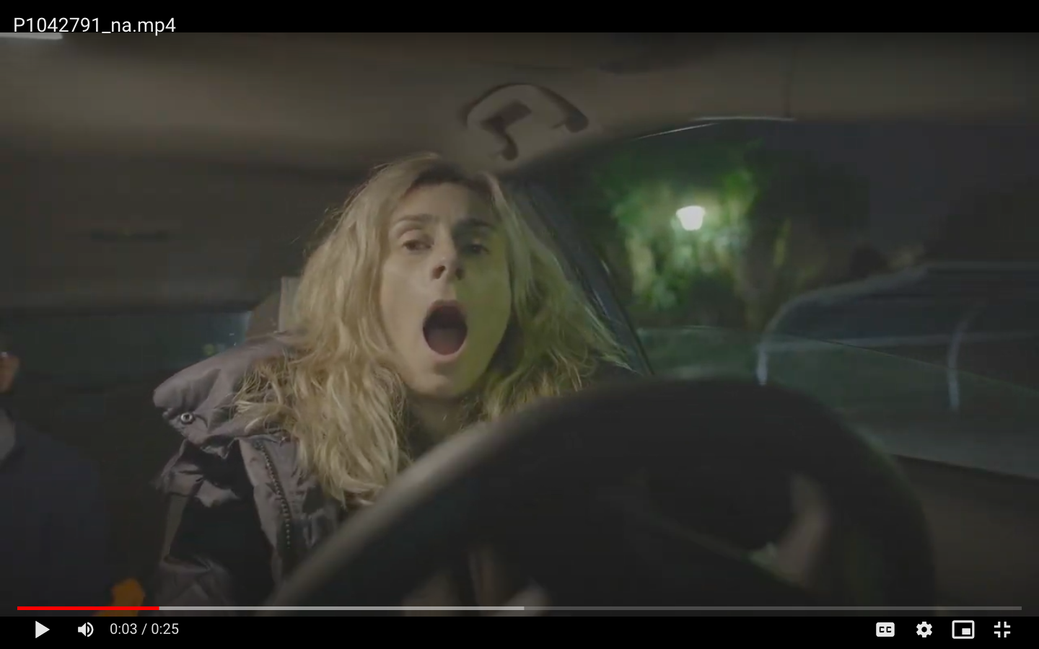
Raw Dataset Sample
The dataset is divided into microsleep and yawning directories while downloading from the source path
Sample of raw dataset from the microsleep directory
Sample of raw dataset from the yawning directory

Slide 18
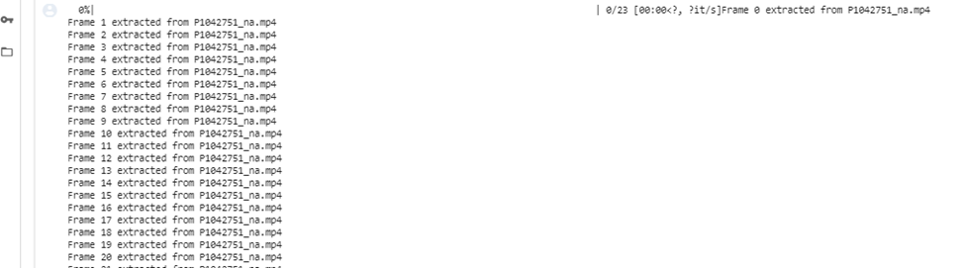
Data Exploration
Output of Frames Extracted From the Videos
Overall 53331 frame level images were extracted combining both yawning and microsleep video dataset
Smallest and Largest Image Dimensions for the entire dataset

Slide 19
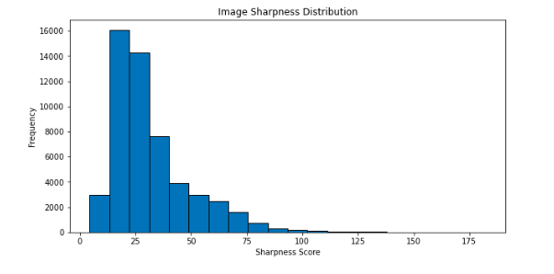
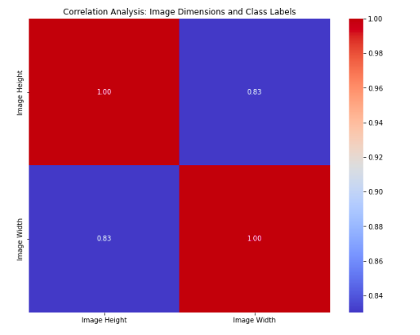
Data Exploration
Image Sharpness Distribution for the entire dataset
Heatmap to show coefficient correlation for the entire dataset

Slide 20
Data Processing
Data Collection
Data Pre-Processing
Data Transformation
Data Preparation
Collecting the raw video dataset from the source path.
Converting the video dataset into a frame level dataset
The frame level dataset is annotated as alert,microsleep and yawning
Missing Data Sampling & Augmentation
Inconsistent Data resizing and scaling all images
Data Smoothing Bilateral filtering Data
Normalization Scaling pixels to 0-1
Data augmentation - Forming different forms of images using rotation and flipping
Data Reduction - PCA
Training Set 80%
Images Validation Set 10%
Images Test Set 10%

Slide 21
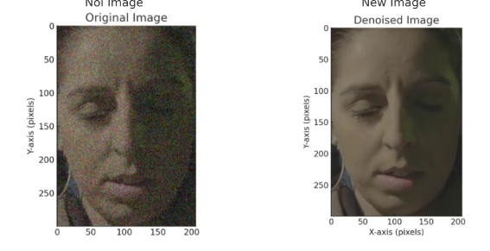
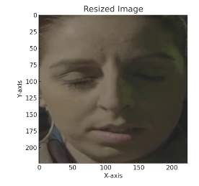
Data Preprocessing
Missing data- Using keras module detected faces from all images and considered images without faces as missing data. No missing data was found.
Inconsistent data- Images are of different sized, they are converted to consistent size which would enhance performance of deep learning model.

Slide 22
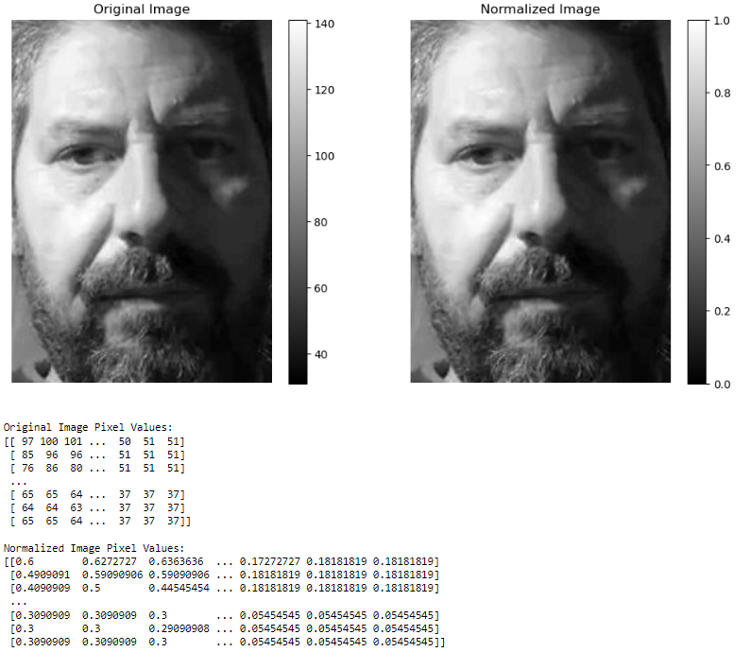
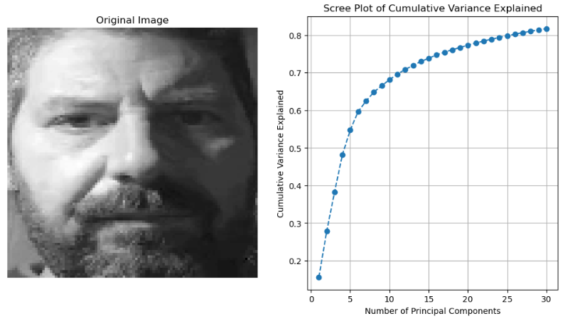
Data Transformation
Smoothing - detection of false edges by applying filters to the image.
Normalization - achieve uniformity without losing the information
Augmentation - widely used to increase the diversity and size of training datasets, helping neural networks generalize better and improve their performance.
Reduction using PCA - Extract smaller primary components to minimize picture matrix dimensionality. These components record important pixel intensity data.

Slide 23
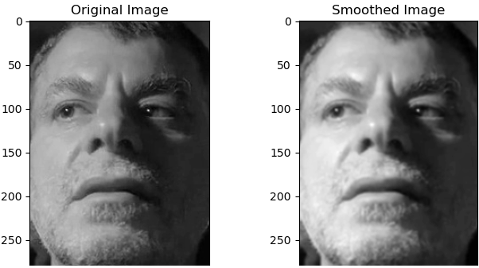
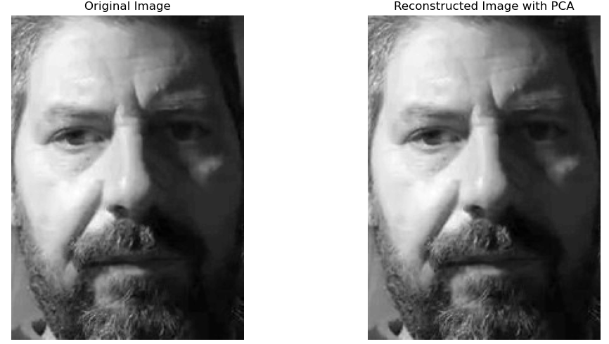
Original vs Transformed Images
Data Smoothing
Reconstructed image using PCA

Slide 24
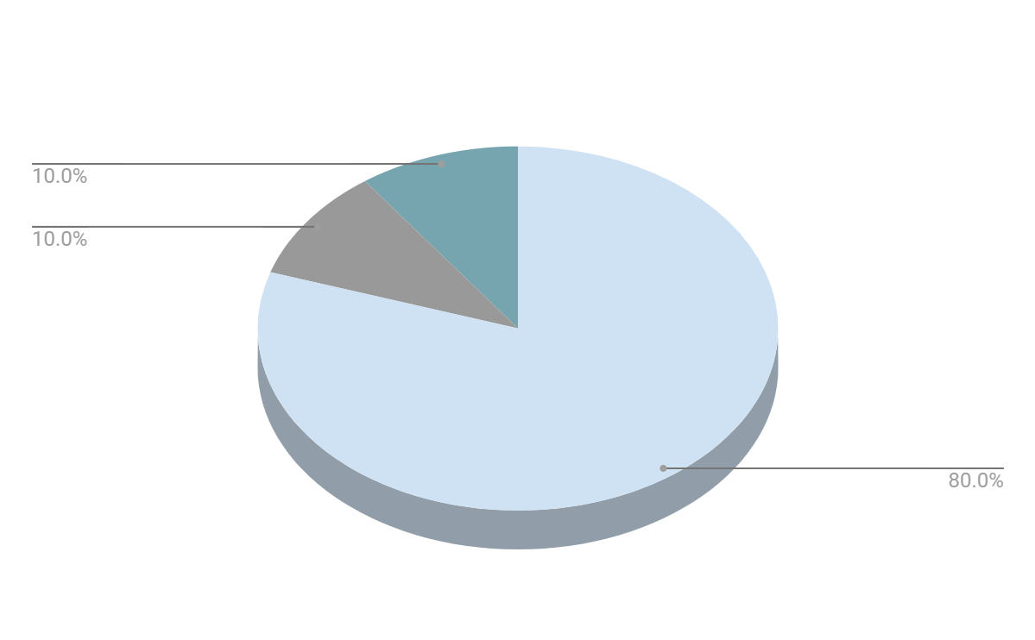
Distribution Of Dataset

Slide 25
Deep Learning Models
By utilizing annotated preprocessed data, dividing dataset in to 3 sets train,test and validation with 80:10:10 ratio.
Training the deep learning models CNN, VGG19, Viola Jones, YOLOV3 using train dataset
After testing the models on test dataset and based on the evaluation metrics like accuracy and f1 score retraining the model for more epochs with different hyper parameters until reaching 30 epochs.
Using the best model evaluating on unseen validation data

Slide 26
VGGNet
Description | Utilizes a Convolutional Neural Network with 19 layers, including 16 convolutional and 3 fully connected layers, employing sequential processing with 3x3 filters to capture intricate facial features related to drowsiness
Advantages | Offers a simple architecture aiding network design, transfer learning, and understanding depth while using smaller filters for feature extraction.
Disadvantages | High computational demands for training and deployment, significant memory usage due to depth, and a tendency to overfit with smaller datasets.
Justification | Known for exceptional image recognition performance in extensive datasets like ImageNet, showcasing its capability to capture detailed features relevant for drowsiness detection
Accuracy | 97%
F1-Score | 95%

Slide 27
CNN
Description | Utilizes convolutional layers to process facial images, pooling layers, and dropout with fully connected layers for analyzing driver-related features indicative of drowsiness.
Advantages | Offers customization, access to pre-trained models, and learns spatial hierarchies in images, making it suitable for detecting subtle facial cues in drowsy drivers.
Disadvantages | Requires iterative experimentation, prone to underfitting due to complex parameter tuning.
Justification | CNN's efficacy in image analysis, particularly in learning hierarchical features, makes it well-suited for detecting drowsiness-related cues in facial expressions of drivers
Accuracy | 77%
F1-Score | 74%

Slide 28
Viola Jones
Description | Utilizes Haar-like features and a cascading structure in face detection, adapted for detecting drowsiness-related facial cues in automobile drivers' images
Advantages | Because of cascaded classifiers and integral images, computation is done quickly. efficient at finding objects under a variety of circumstances,offers minimal false positive rates and generally high detection rates.
Disadvantages | Sensitivity to drastic illumination changes, demanding considerable processing power for effective classifier training, primarily intended for facial recognition and not generalize well for drowsiness detection in drivers.
Justification | The computational efficiency of Haar features and the cascade structure makes it suitable for real-time drowsiness detection applications. Although designed for faces, adaptations can be used for broader object detection tasks
Accuracy | 86%
F1-Score | 76%

Slide 29
YOLOV3
Description | Employs the YOLO (You Only Look Once) v3 object detection framework. Trains on an image dataset that contains annotations of face expressions or behaviors associated with drowsiness Equipped with the ability to promptly identify signs of fatigue in automobile drive.
Advantages | YOLOv3 is renowned for its rapidity in object recognition tasks, making it possible to recognize indicators of tiredness in photos with ease. Possesses a reasonable degree of object detection accuracy and has the ability to identify minor facial expressions associated with sleepiness. Increases efficiency for real-time applications by processing the full image in a single session.
Disadvantages | For characteristics unique to drowsiness considerable dataset correction or fine-tuning may be required, which can take time. May have trouble with occlusions or different lighting conditions, which could affect the accuracy of the detection. The computational demands of YOLOv3 may necessitate the use of sophisticated hardware for real-time processing in vehicle environments.
Justification | Due to its speed and accuracy, YOLOv3 is a good option for real-time drowsiness detection in car safety systems. Even with its drawbacks, more study and model advancements increase its relevance.
Accuracy | 88%
F1-Score | 80%

Slide 30
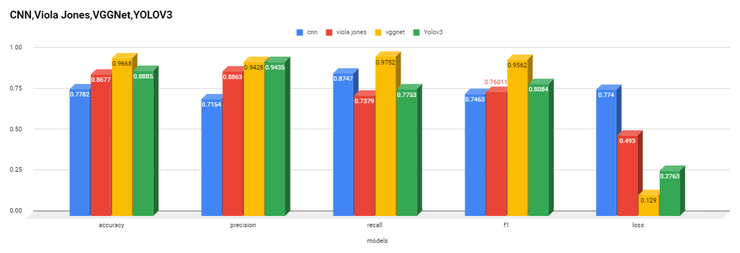
Model Comparison
Based on this VGGNet is having the best evaluation metrics out of all four models

Slide 31
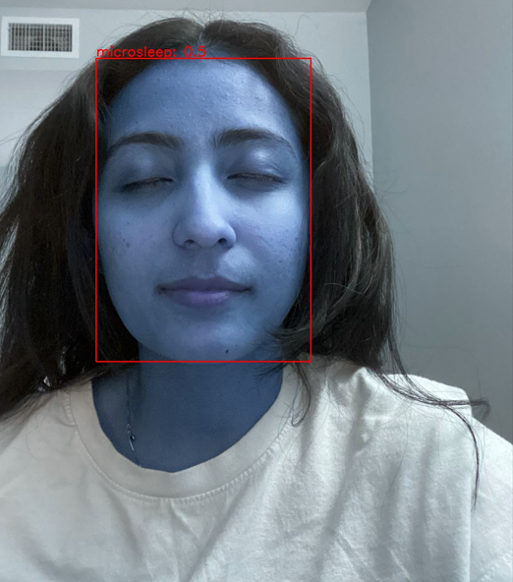
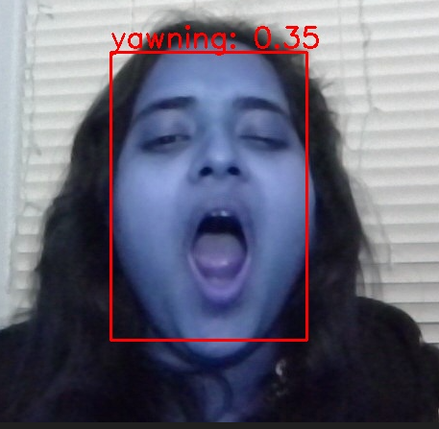
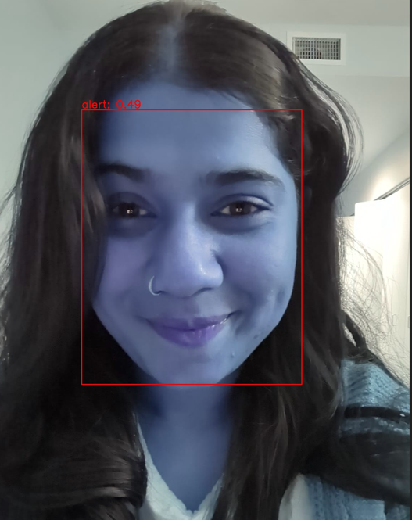
Inference
Using the best model from VGG19 classifying and annotating the above images

Slide 32
Conclusion
A significant advancement in the detection of driver drowsiness has been made possible by the integration of various deep learning models, including CNN, VGGNet, Viola-Jones, and YOLOv3.
Each model has its own advantages and improves road safety by detecting drowsiness quickly, accurately, and versatilely but VGGNet algorithm is a strong candidate in this project as it excels in identifying and classifying image features, which makes it suitable for detecting subtle changes in a driver's facial expressions or eye movements indicative of drowsiness.

Slide 33
Future Work
Intends to combine these deep learning models into a single framework to optimize real-time monitoring and intervention tactics to minimize driver drowsy accidents.
Multi-Modal Data Integration by combining data from various sources, hand gestures, physiological signals (heart rate, skin conductivity), and driving patterns, can provide a more comprehensive assessment of the driver’s state.

Slide 34
References
Afsar, P., Shanid, M., Verghese, A., Sithara, A., Pakarath, A., Bijoy, & Ashmin, K. T. (2023). Real-Time Student Emotion and Drowsiness Detection Using YOLOv5 and CNN for Enhanced Learning. IEEE. https://doi.org/10.1109/iciet57285.2023.10220929
Ali, N., Hasan, I., Özyer, T., & Alhajj, R. (2021b). Driver drowsiness detection by employing CNN and Dlib. 2021 22nd International Arab Conference on Information Technology (ACIT). https://doi.org/10.1109/acit53391.2021.9677197
Bajaj, P., Ray, R., Shedge, S., Jaikar, S., & More, P. (2021). 2021 7th International Conference on Advanced Computing and Communication Systems (ICACCS). IEEE. https://doi.org/10.1109/icaccs51430.2021.9441670
Dua, M., Shakshi, Singla, R., Raj, S. a. A., & Jangra, A. (2020). Deep CNN models-based ensemble approach to driver drowsiness detection. Neural Computing and Applications, 33(8), 3155–3168. https://doi.org/10.1007/s00521-020-05209-7
Kielty, P., Dilmaghani, M. S., Shariff, W., Ryan, C., Lemley, J., & Corcoran, P. (2023b). Neuromorphic Driver Monitoring Systems: A Proof-of-Concept for Yawn Detection and Seatbelt State Detection using an Event Camera. IEEE Access, 11, 96363–96373. https://doi.org/10.1109/access.2023.3312190
Lazuardi, M. R., Hadi, M. Z. S., & Sudibyo, R. W. (2023). Driver Drowsiness Detection System Using Deep Learning Method to Reduce Risk Accident. IEEE. https://doi.org/10.1109/ies59143.2023.10242431
Luo, G. (2023b). YOLOv5 -based Fatigued Driving Detection. IEEE. https://doi.org/10.1109/icsece58870.2023.10263342
Macalisang, J., Alon, A. S., Jardiniano, M. F., Evangelista, D. C. P., Castro, J. C., & Tria, M. L. (2021). Drive-Awake: A YOLOv3 Machine Vision Inference Approach of Eyes Closure for Drowsy Driving Detection. IEEE. https://doi.org/10.1109/iicaiet51634.2021.9573811

Slide 35
References
Neshov, N., & Manolova, A. (2017b). Drowsiness monitoring in real-time based on supervised descent method. IEEE. https://doi.org/10.1109/idaacs.2017.8095173
Rivelli, E. (2022). Drowsy Driving Statistics. Bankrate. https://www.bankrate.com/insurance/car/drowsy-driving-statistics/
Soman, S., Kumar, G. S., & Abubeker, K. M. (2023). Internet-of-Things-Assisted Artificial Intelligence-Enabled Drowsiness Detection Framework. IEEE Sensors Letters, 7(7), 1–4. https://doi.org/10.1109/lsens.2023.3289143
Tyagi, N., Goyal, R., & Rautela, R. (2022). Real Time Drowsiness Detection System. 2022 International Conference on Cyber Resilience (ICCR). https://doi.org/10.1109/iccr56254.2022.9996053
Yauri-Machaca, M., Meneses-Claudio, B., Vargas-Cuentas, N. I., & Román-Gonzalez, A. (2018). Design of a Vehicle Driver Drowsiness Detection System Through Image Processing using Matlab. IEEE. https://doi.org/10.1109/concapan.2018.8596513
Yazici, B., Özdemir, A., & Ayhan, T. (2022b). System-on-Chip based driver Drowsiness Detection and Warning System. 2022 Innovations in Intelligent Systems and Applications Conference (ASYU). https://doi.org/10.1109/asyu56188.2022.9925481

Slide 36
Thank you! Q&A

